Slide 1
Welcome Future Greyhounds!
Career & Technical Education (CTE)
1 Practical Art Credit Required for Graduation
(½ credit from Personal Finance-Jr/Sr year)

Slide 2
Where education meets
the real world.

Slide 3
Journalism
Video Production (9-12)
Yearbook Production (9-12)
Yearbook Editorial Leadership (10-12)
Photojournalism For Publication (10-12)
Newspaper Writing (9-12)
Newspaper Editorial Leadership (10-12)
Online Journalism and Social Media (9-12)
Mrs. Erin Sucher-O’Grady
Dr. Marci Pieper
Mr. Justin Seiwell

Slide 4
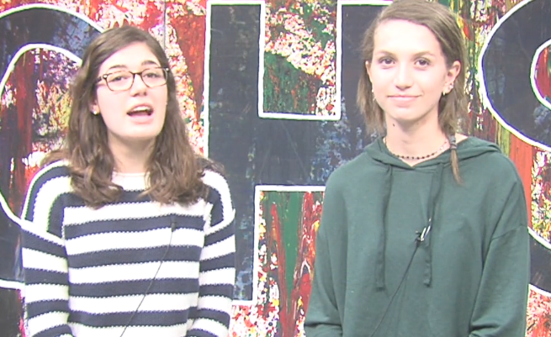
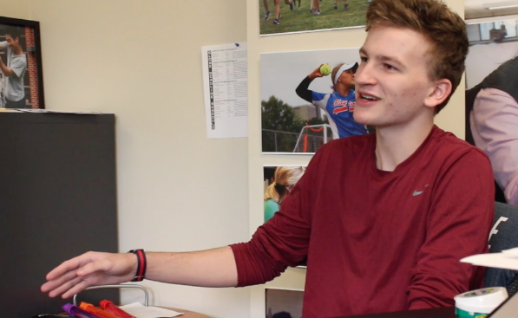
GNN/GET
YEARBOOK

Slide 5
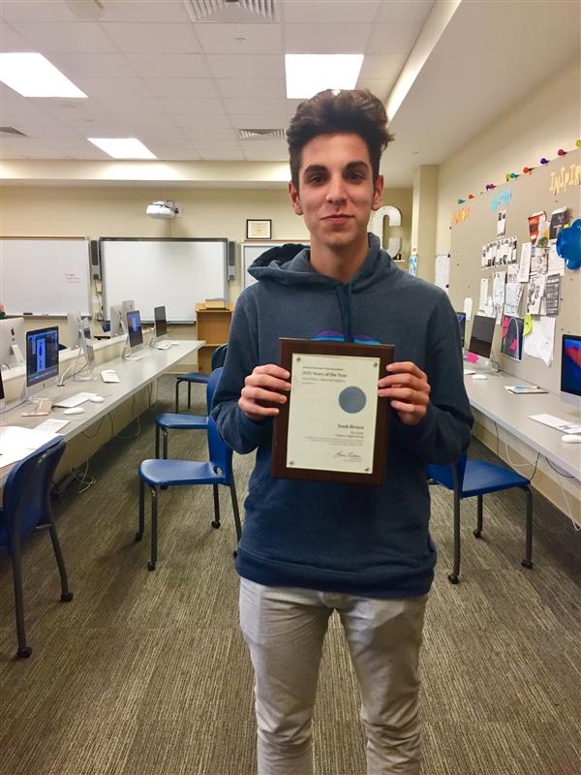
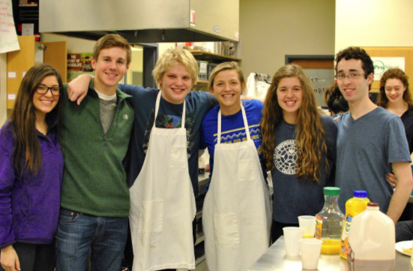
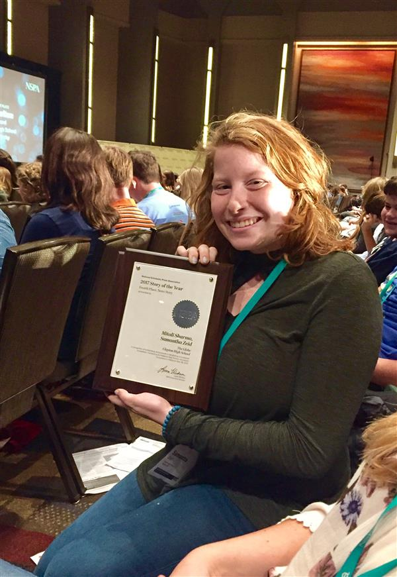
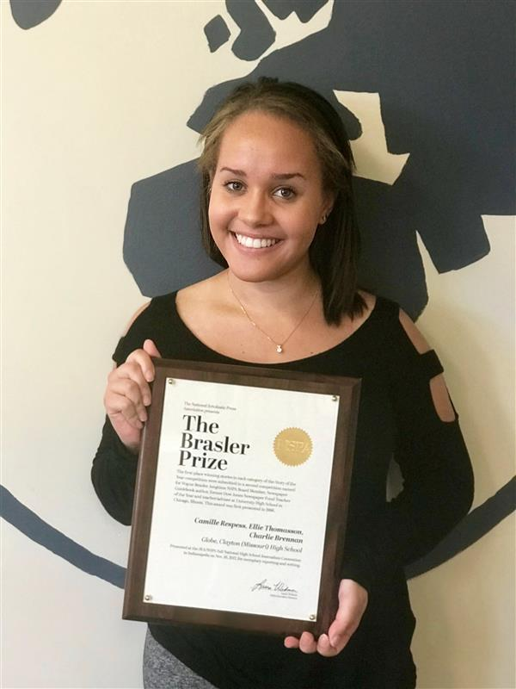
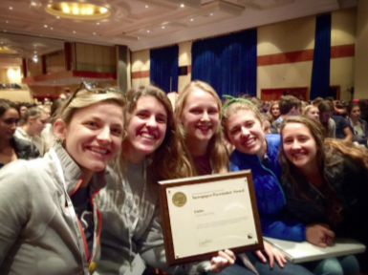

Slide 6
PLTW-Project Lead the Way
Principles of Engineering (PLTW)*+
Introduction to Engineering Design (PLTW)*+
Digital Electronics (PLTW) *+
Civil Engineering and Architecture (PLTW)*+
Engineering Design and Development (PLTW) *+ Computer Science Principles *
Construction Technology
* Full Year Course + Math Requirement - All courses 9-12
Mr. Steve Beauchamp

Slide 7
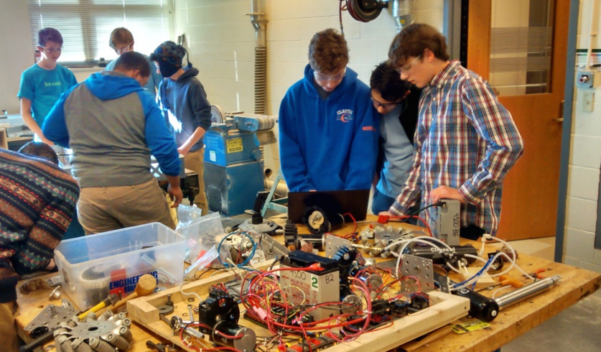
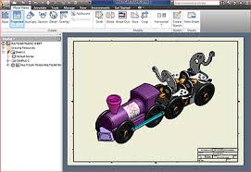
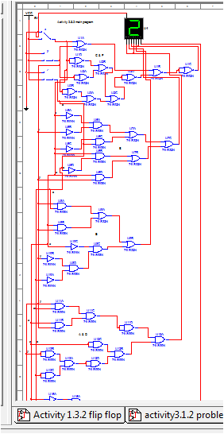
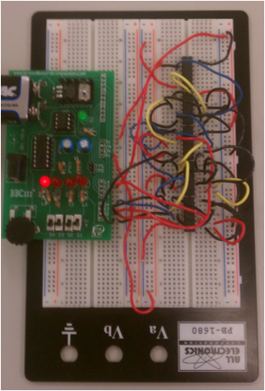
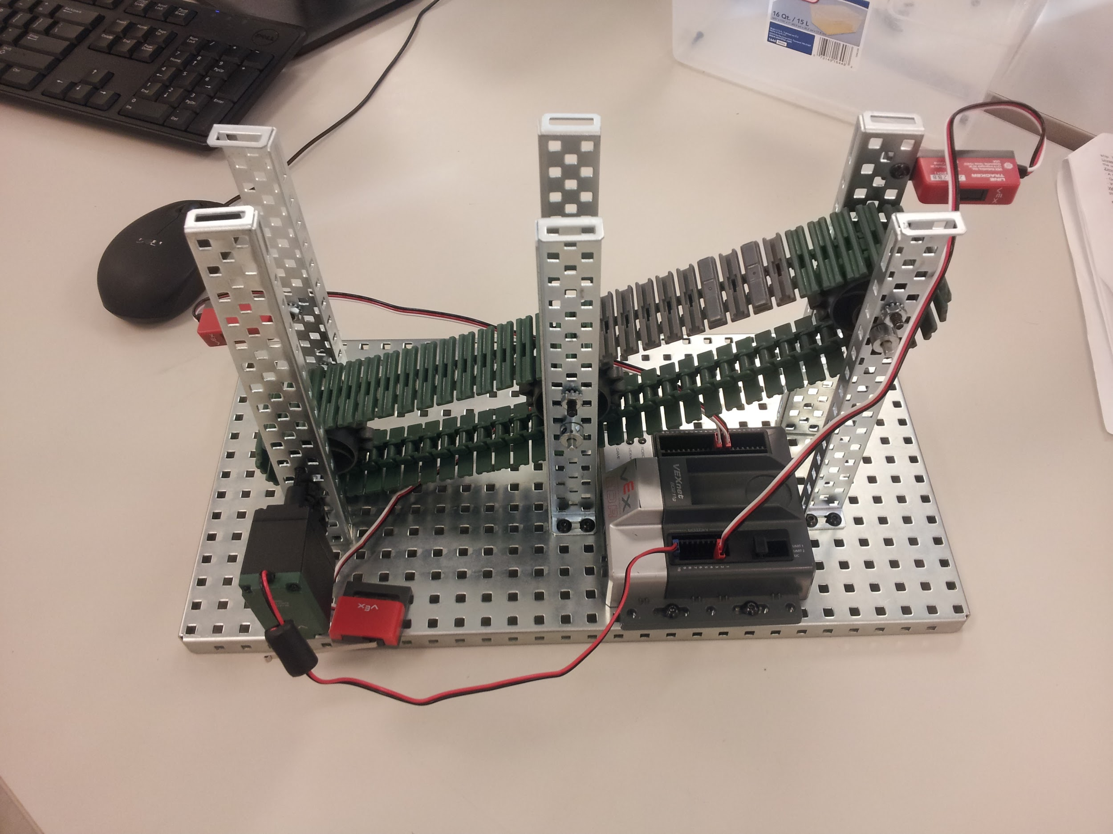
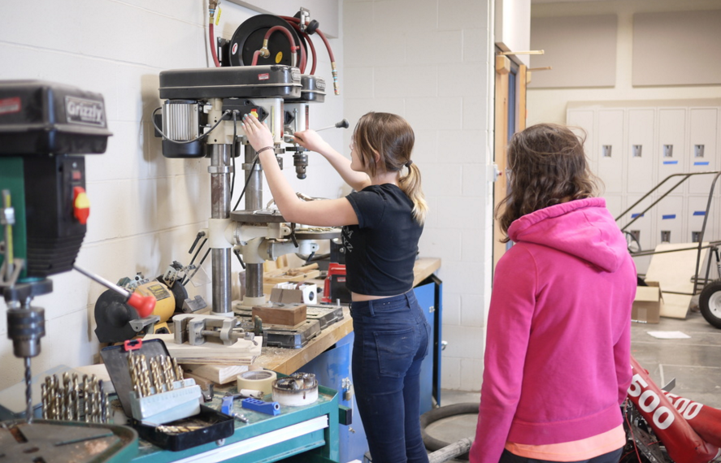
Clayton Engineering and Computer Science

Slide 8
FACS
Family and Consumer Sciences
Child Development 1
Fashion Design 1
Interior Design 1
Advanced Fashion and Interior Design
Culinary Arts 1 (ProStart Program)
Culinary Arts 2 (ProStart Program)
** All courses 9-12
Dr. Lauren Compton
Follow us on Instagram @facswithdrc

Slide 9
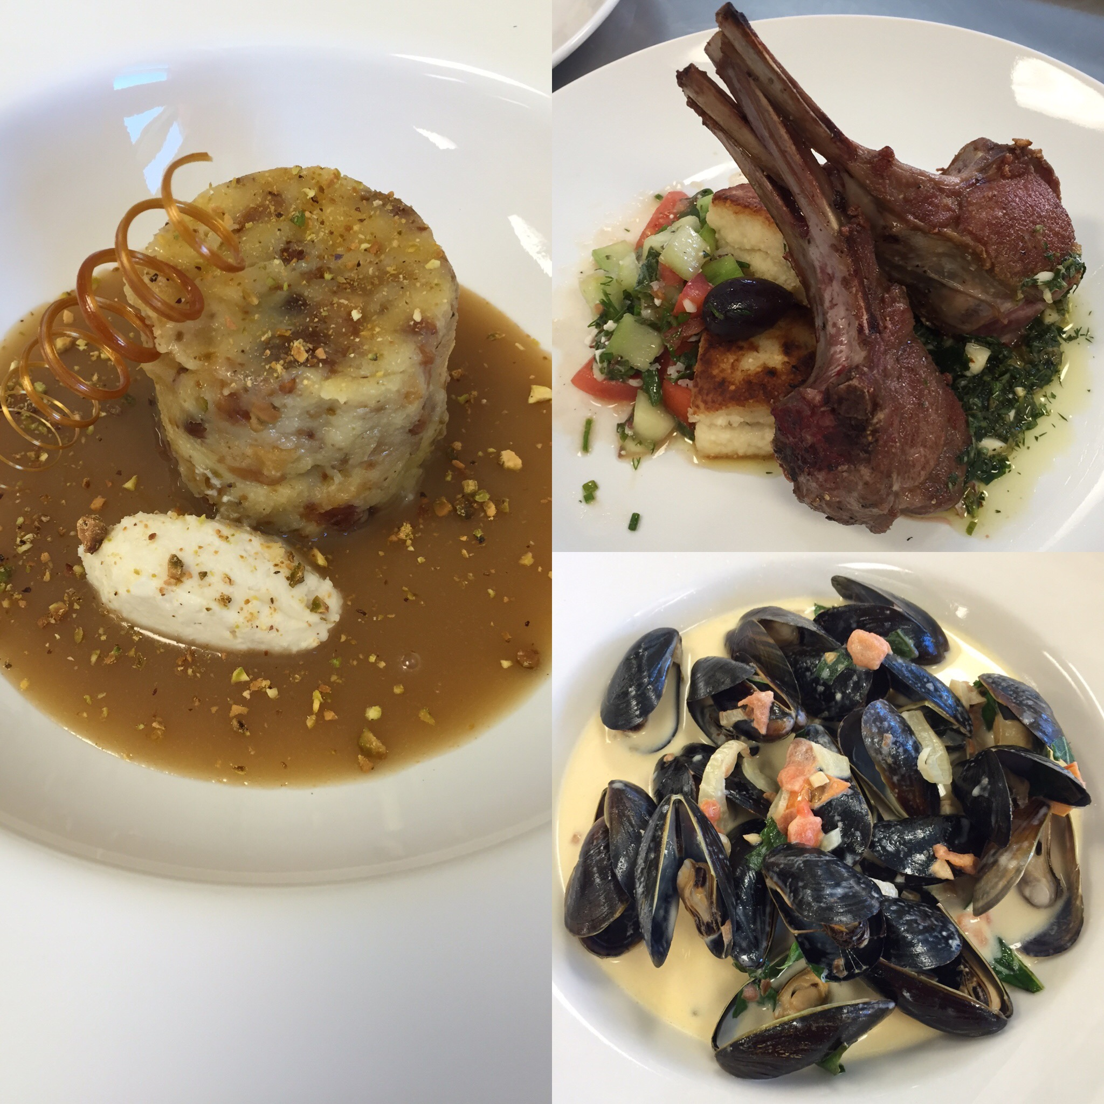
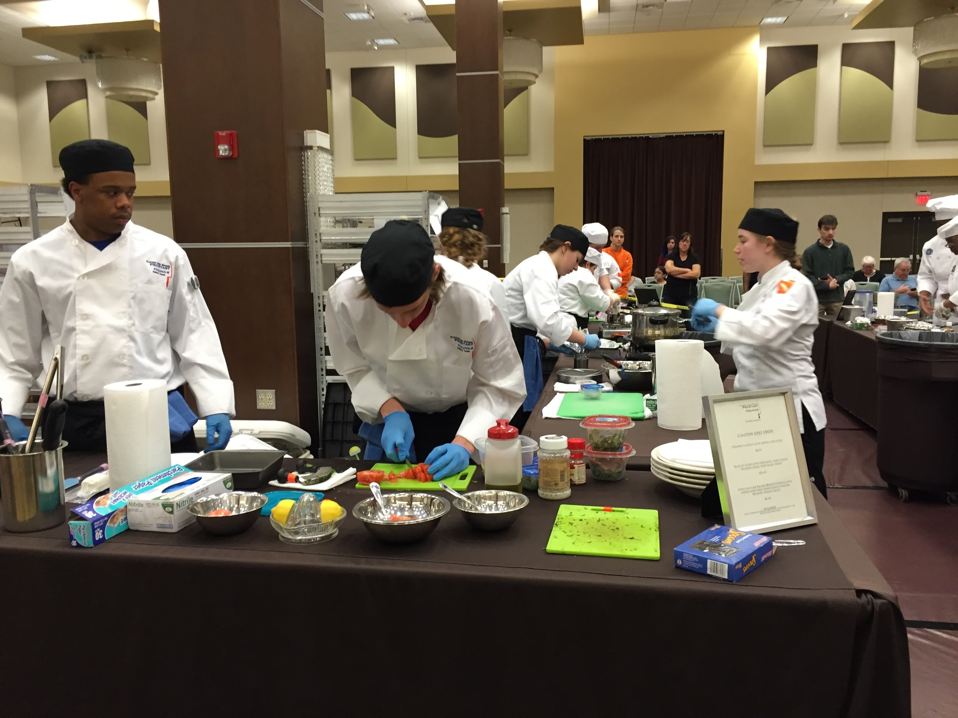
Clayton High School Culinary Program was named an Elite 50 Member by Sullivan University for the 2017-2018 year!
2nd Place
2016 Missouri ProStart State Invitational

Slide 10
Business, Marketing, and Entrepreneurship
Courses Available
Intro to Business (9-12)
Business and Personal Law (9-12)
Business Management (10-12)
Financial Computerized Accounting (10-12) Personal Finance (GRAD REQUIREMENT) (11-12)
Marketing I (10-12)
Marketing II (10-12) Marketing Research (zero hour) (11-12) Small Business Enterprise (zero hour) (11-12)
Global Business and Entrepreneurship: The Clayton Catalyst (11-12)
Mr. Justin Hildebrand
Mr. Ty Cochran
@mrhildeteaches
@clayton.deca
@mrhildeteaches
@greyhound_deca

Slide 11
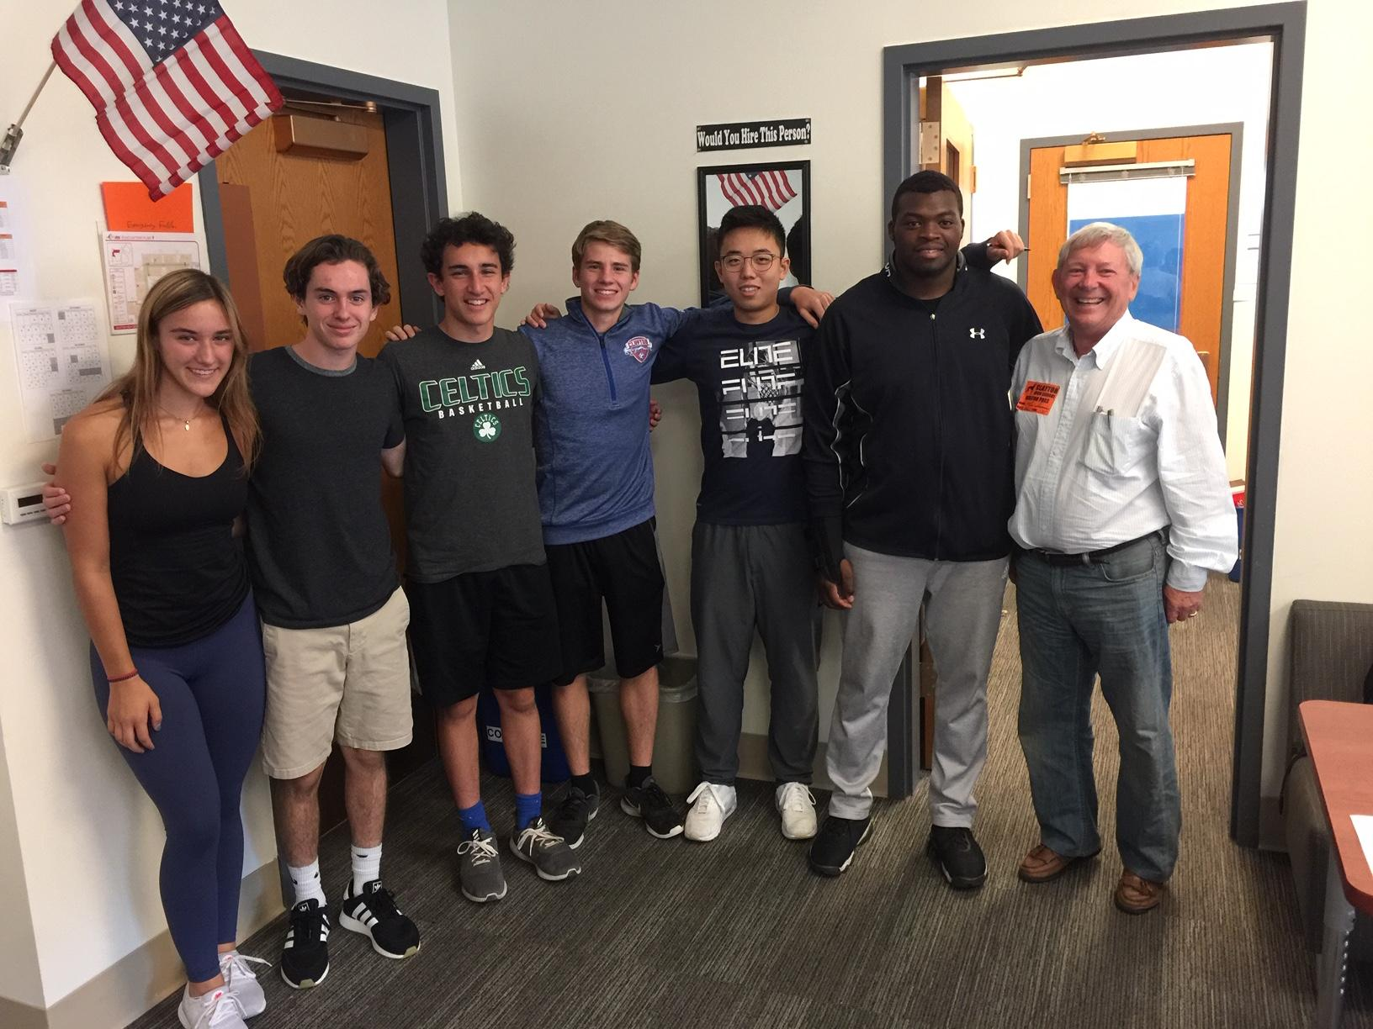
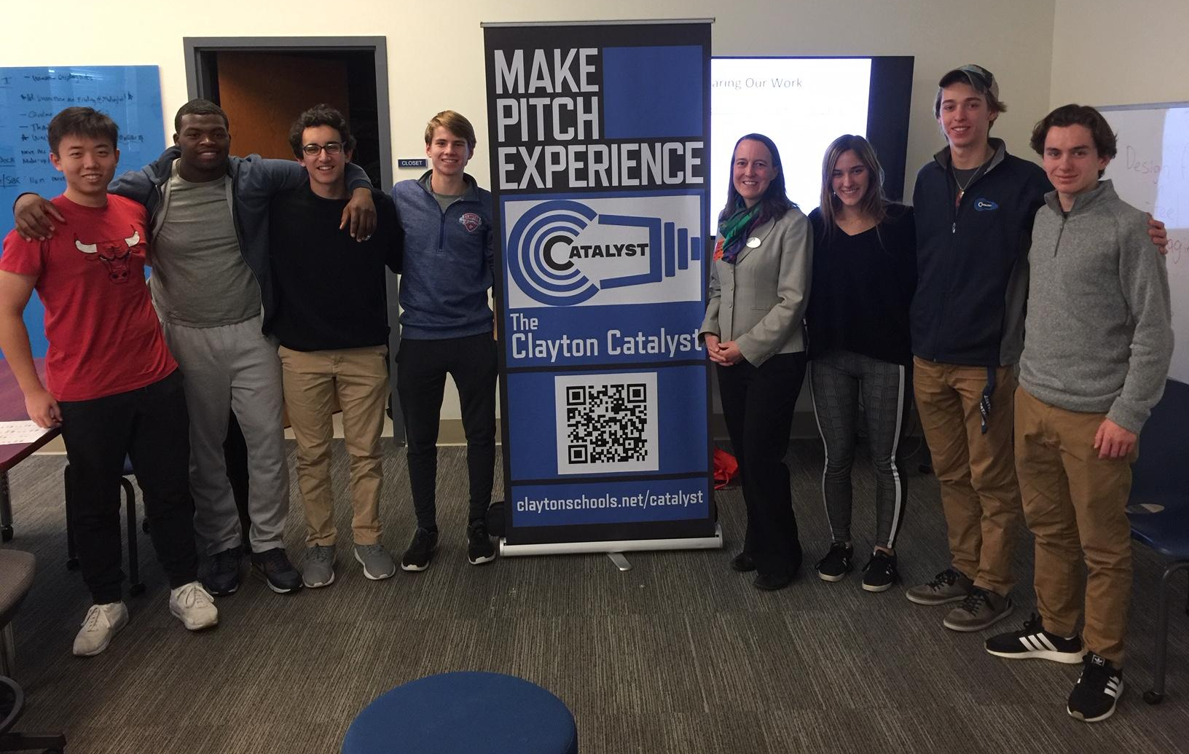
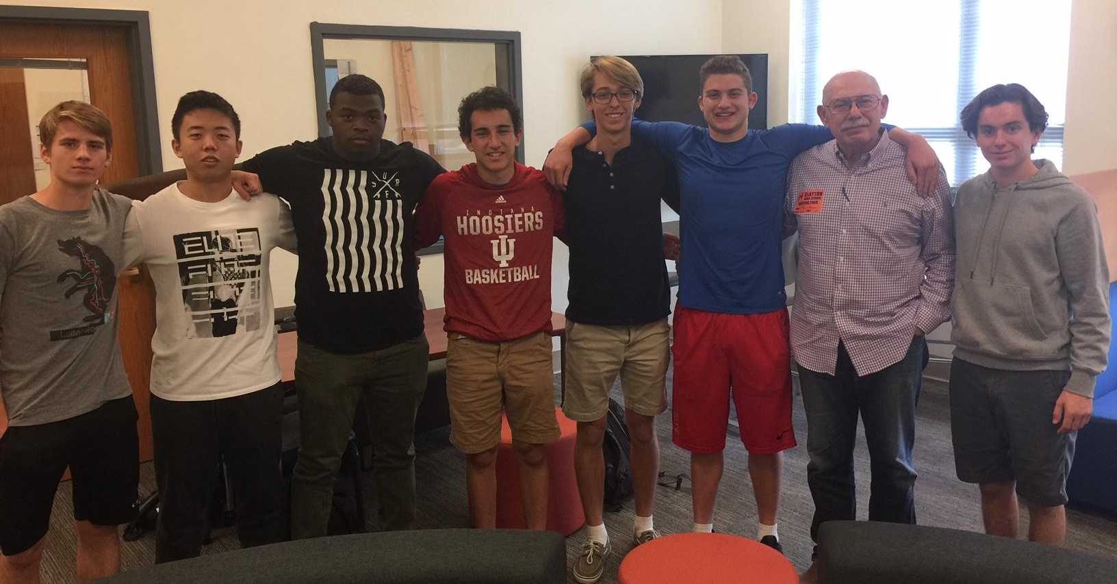
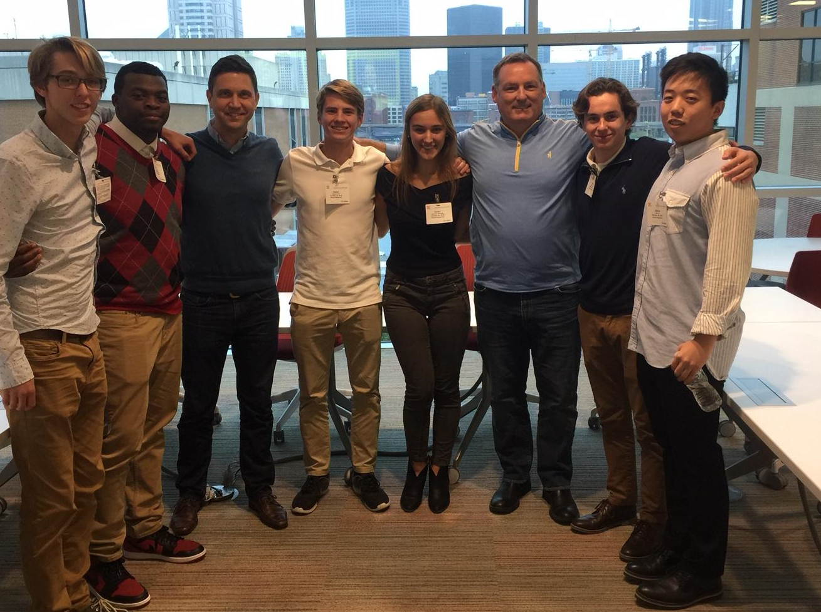
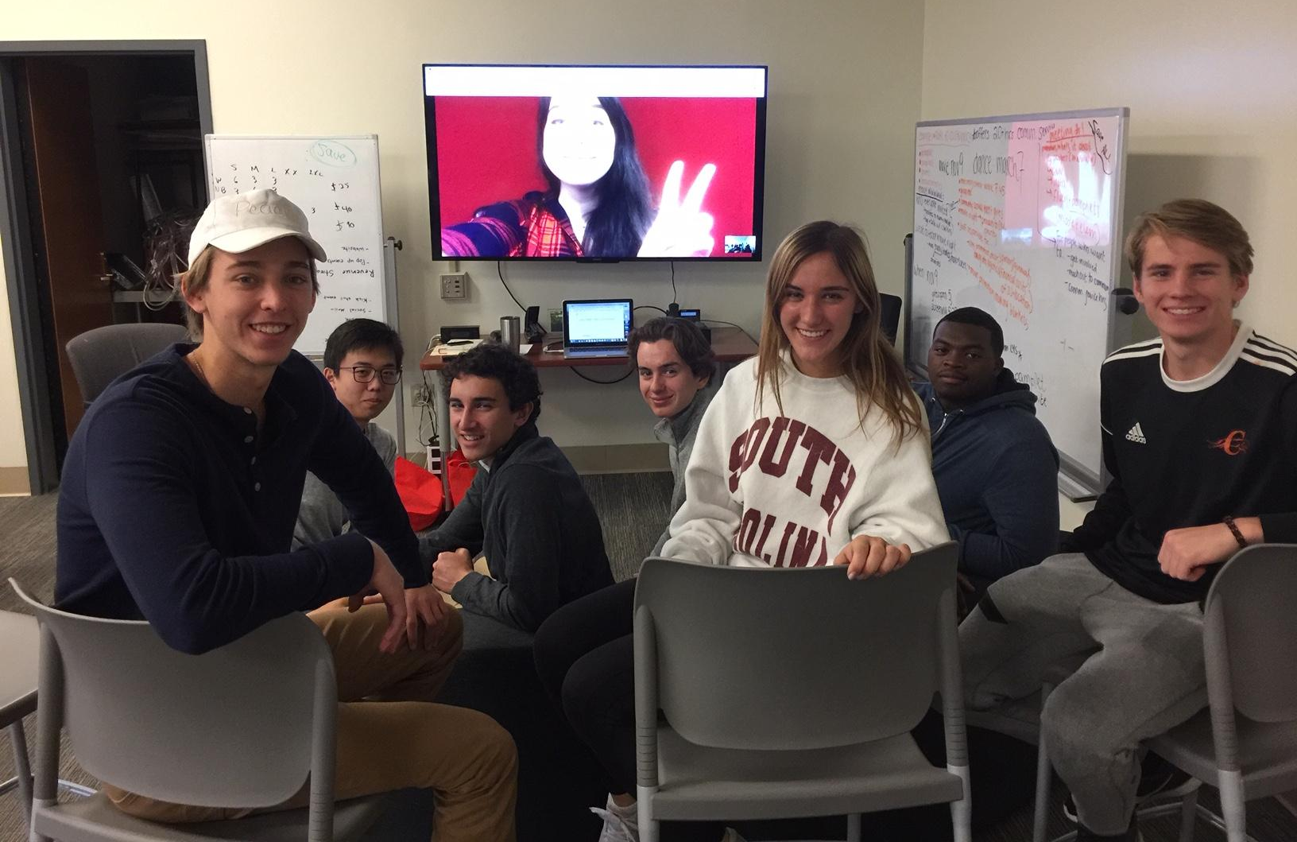
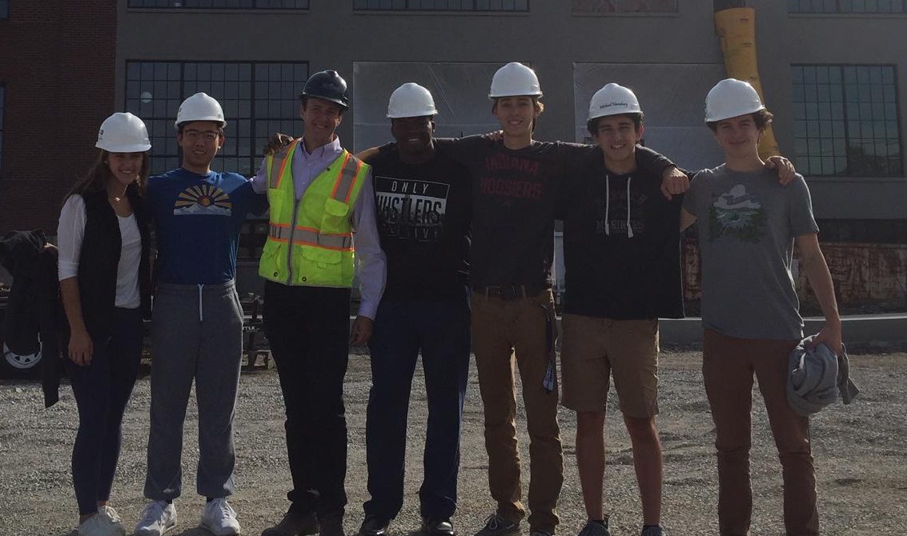
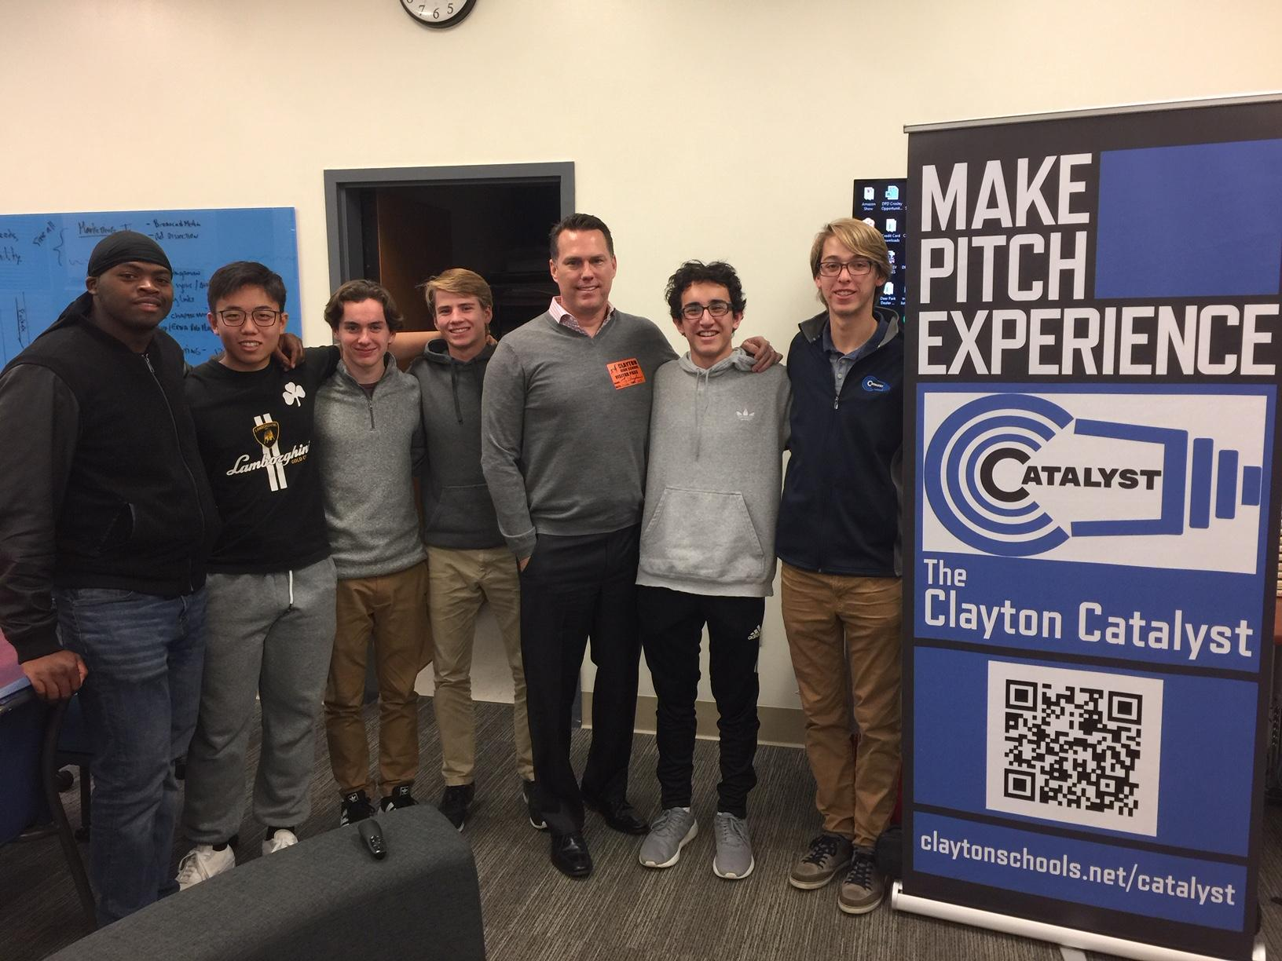
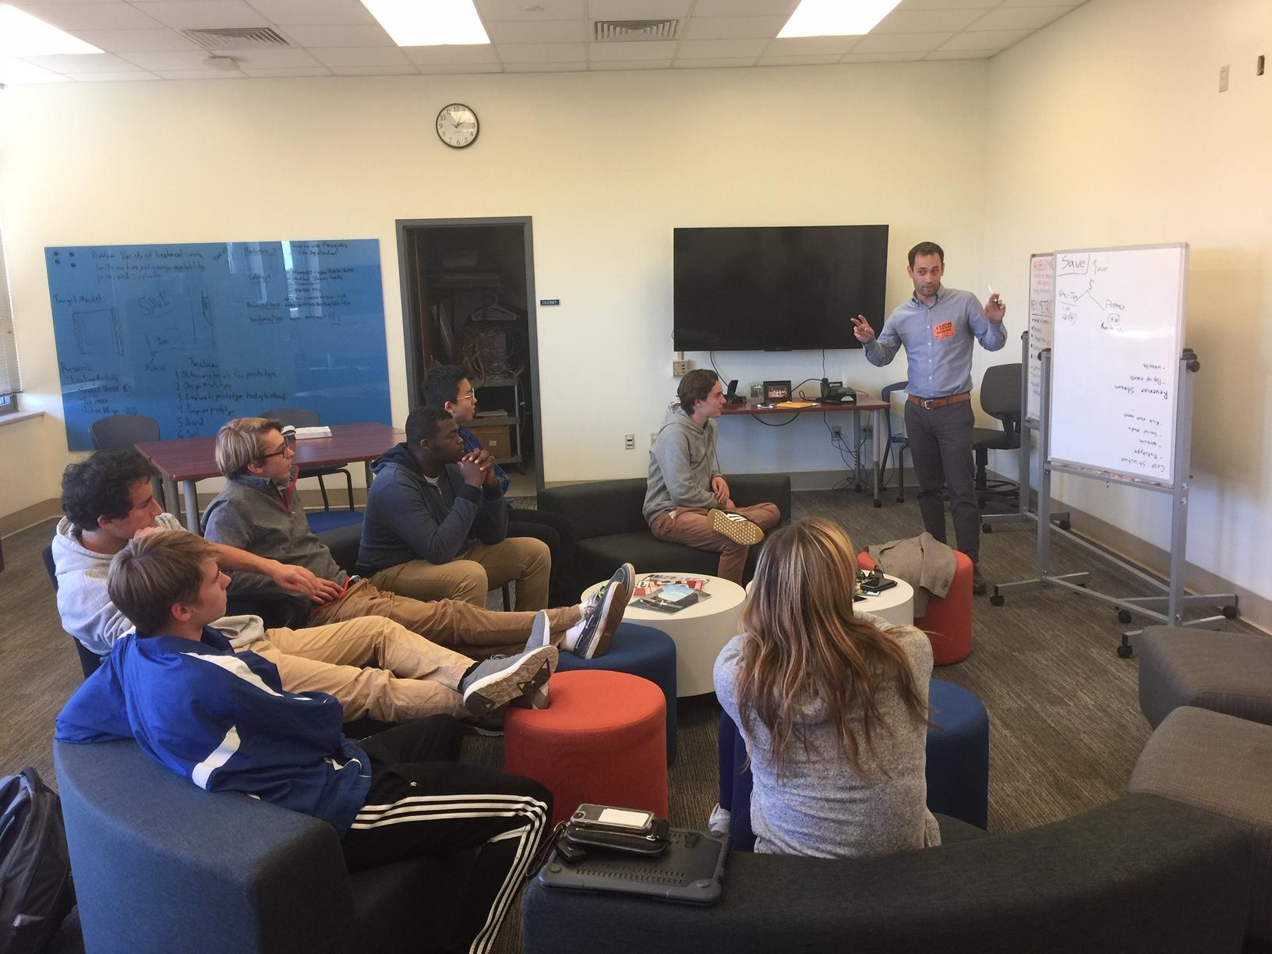
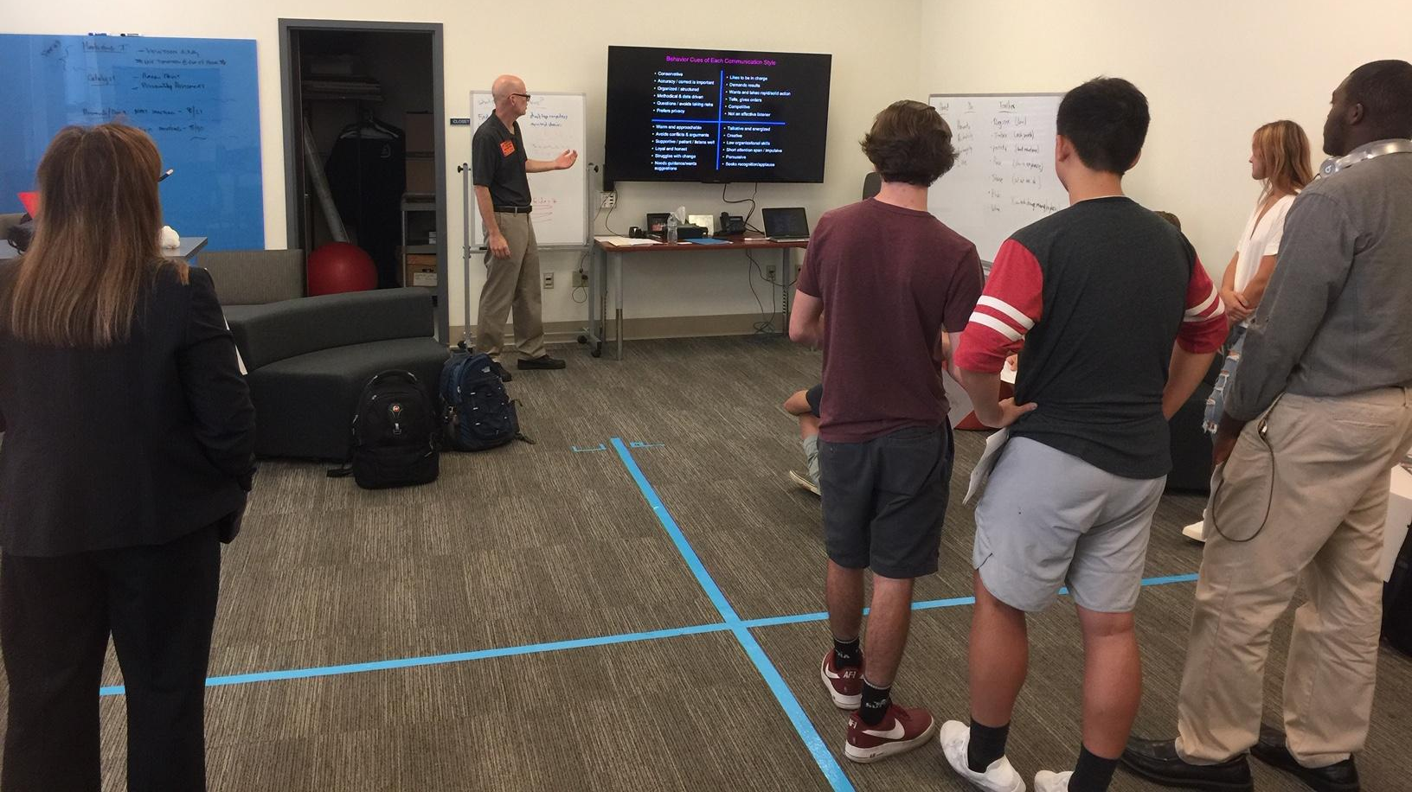
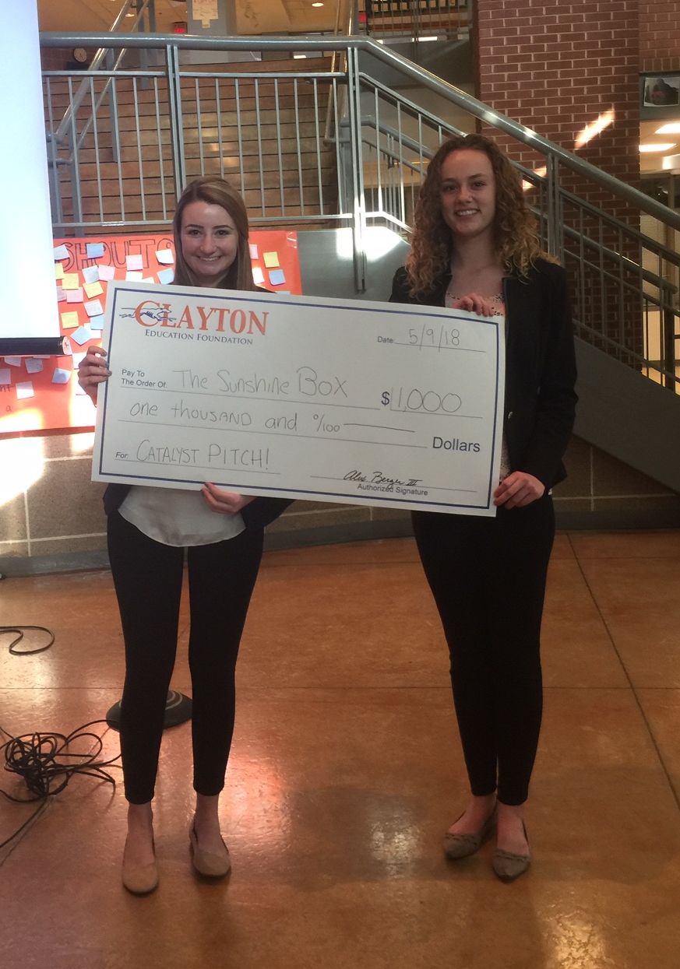
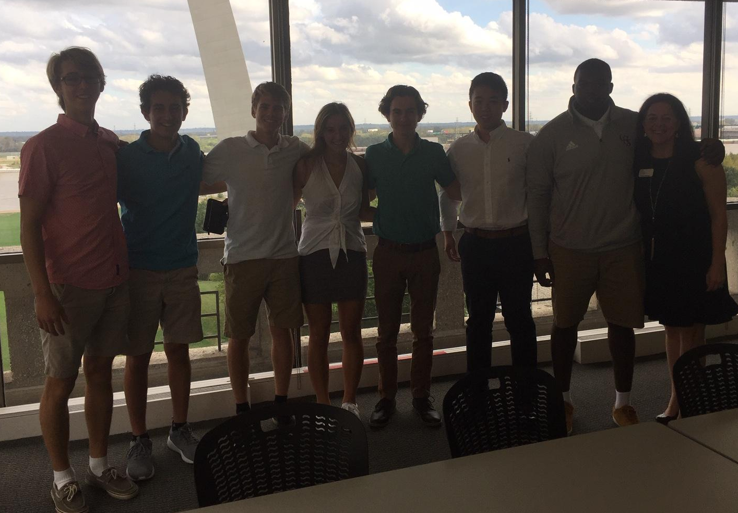
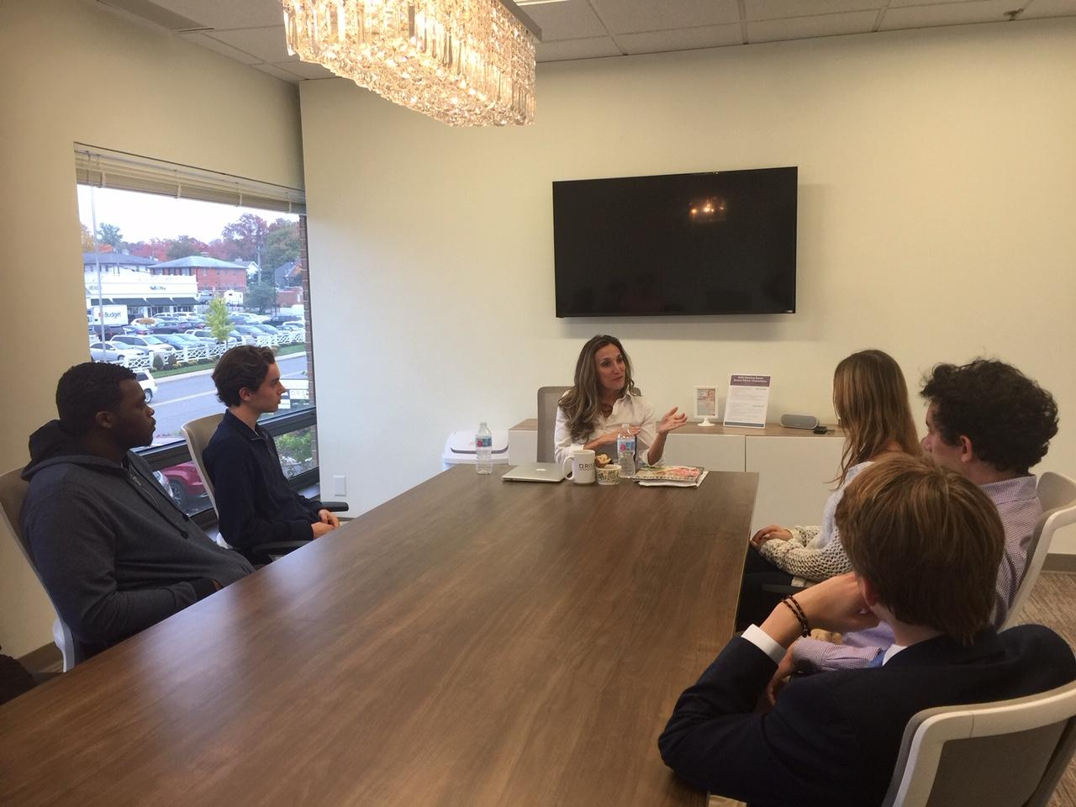
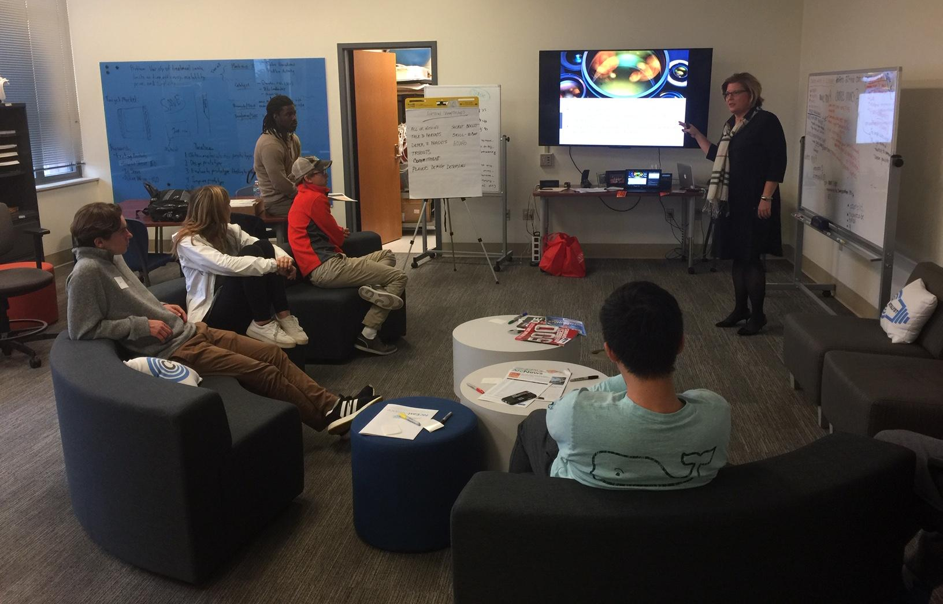
The Clayton
Business Partner Projects
Site Visits
Pitch Competition
Internships
Notes:
Experiential Learning
Professional Immersion

Slide 12
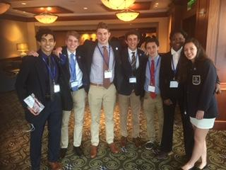
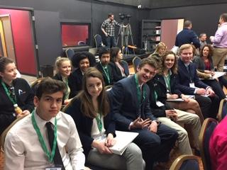
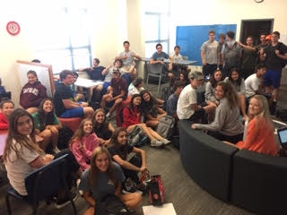
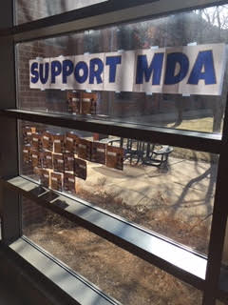
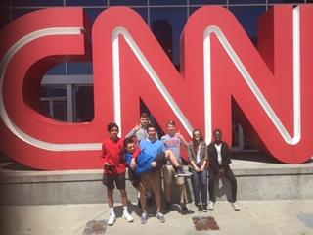
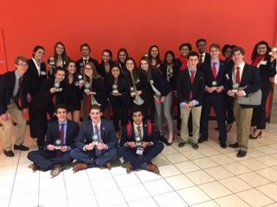
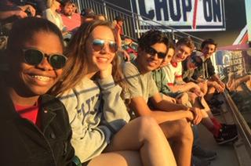
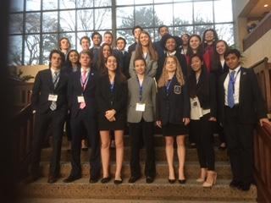
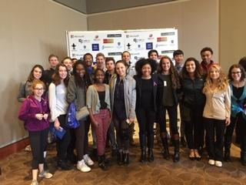
What is DECA?
Social Events
Raise Money
Build a Network
Scholarships
Enhance Your Knowledge and Skills in Business and Marketing
Meet New People
Travel to Exciting Places
Win Awards and Trophies
Notes:
Social Events
Raise Money for Charity
Build Future Business Connections
Scholarships
Enhance Your Knowledge and Skills in Business and Marketing
Meet New People
Travel to Exciting Places
Win Awards and Trophies

Slide 13
Any questions?

